Slide 1
QuickU Demand Forecasting & Stock Planning
August 2022
By Mikhael Putra Iswanto
Looker Slide

Slide 2
01
Introduction

Slide 3
Business Overview
10 Categories
5 Hub (Locations)
28 Weeks
Consisting of: Vegetables & Fruits, Milk & Dairy Products, Cooking Ingredients & Seasonings, Cooking Kits, Snacks, Frozen Meat, Beverages, Frozen Foods, Protein (Chicken & Eggs), Staple Foods
Total weeks over 7 months

Slide 4
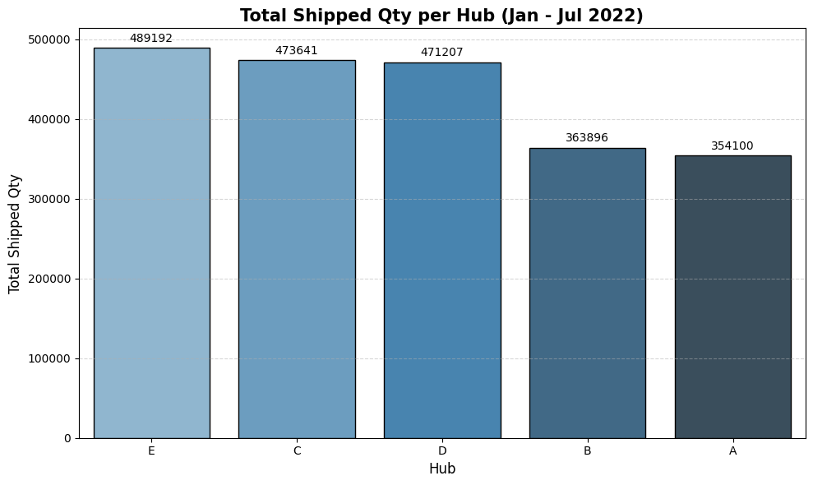
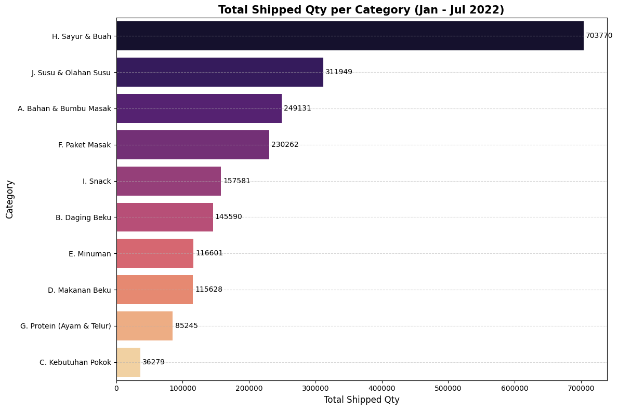
Business Overview
The highest demand is in the fresh product category, especially vegetables and fruits.
Hubs E, C, and D are core operational hubs that support most of the demand.
The business model seems to be more focused on fast-moving fresh goods than basic necessities.

Slide 5
02
Business Question

Slide 6
Business Question
Business Problems
Objectives
Project Scope
Determine the most accurate forecasting method and predict demand for August 2022, using available historical data, with completion prior to August stock preparation.
August 2022 demand forecast for the new hub using the available historical dataset.
Select the method with the lowest error.
Complete the analysis before the stock preparation process begins
predict demand for August 2022 from historical data januari - july 2022

Slide 7
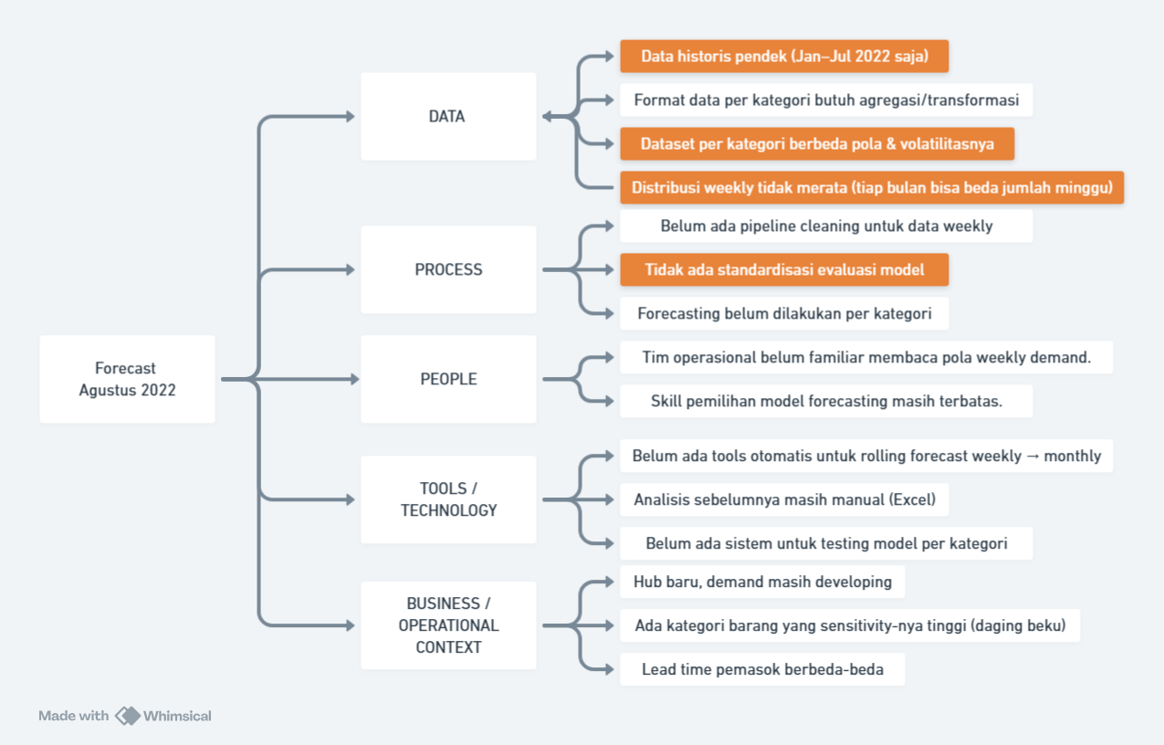
Root
Cause
Analysis

Slide 8
03
Analysis
EDA & Forecast
Python

Slide 9
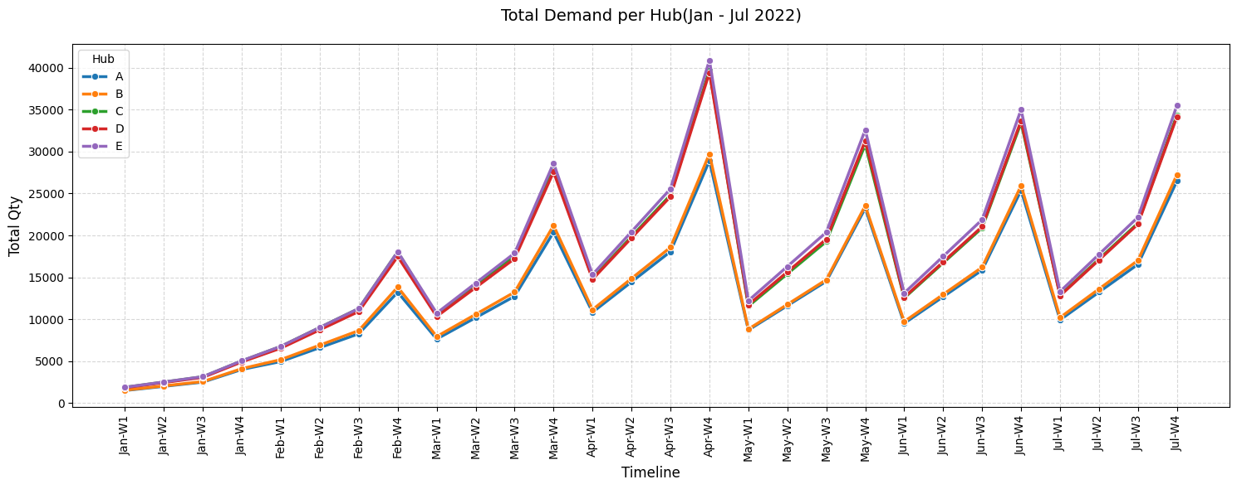
Model Multiplicative

Slide 10

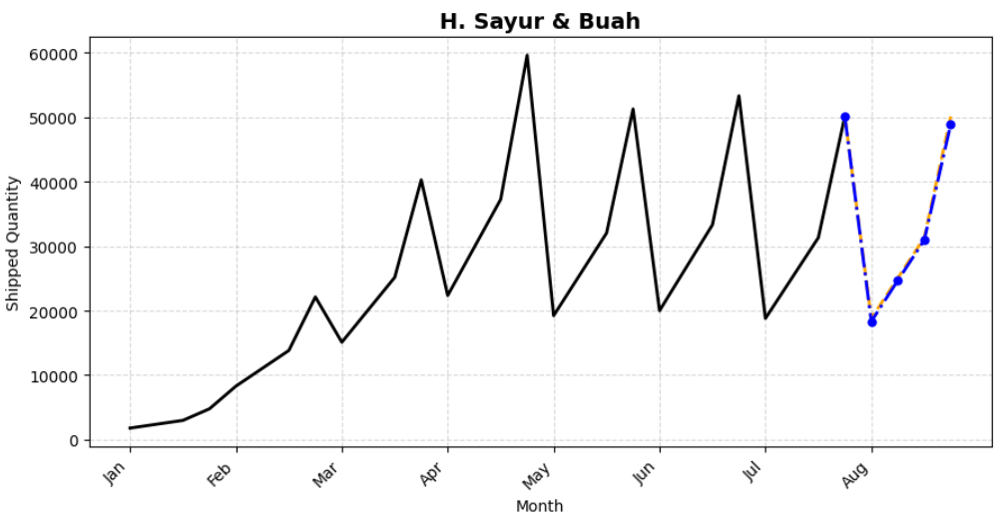
EDA - Vegetables & Fruits
Model Forecast Comparison
Model Forecast Comparison
Sensasional Naive
125297
Holt-Winters
123409
MAPE 6.38% | MAPE 18.94%
Accuracy 93.62% | Accuracy 81.06%

Slide 11

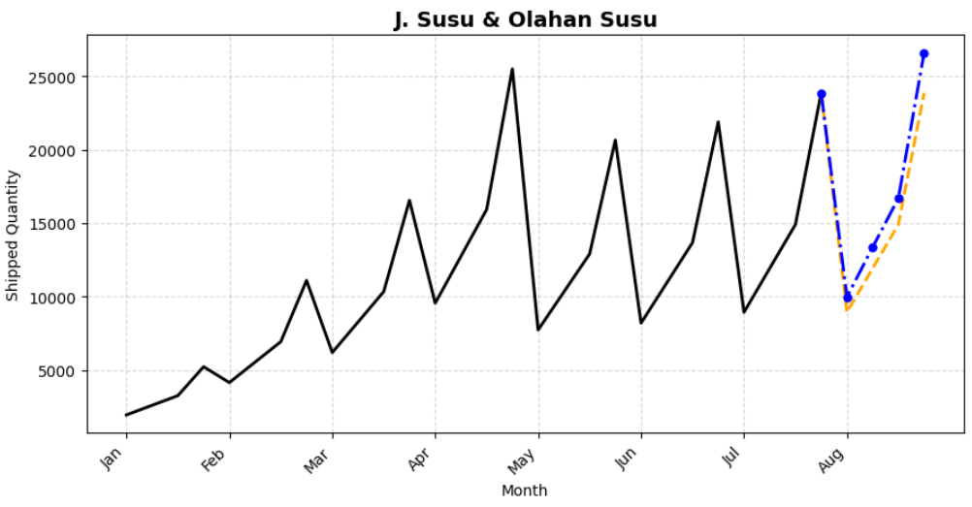
EDA - Milk & Dairy Products
Model Forecast Comparison
Model Forecast Comparison
Sensasional Naive
59641
Holt-Winters
67108
MAPE 8.25% | MAPE 3.69%
Accuracy 91.75% | Accuracy 96.31%

Slide 12

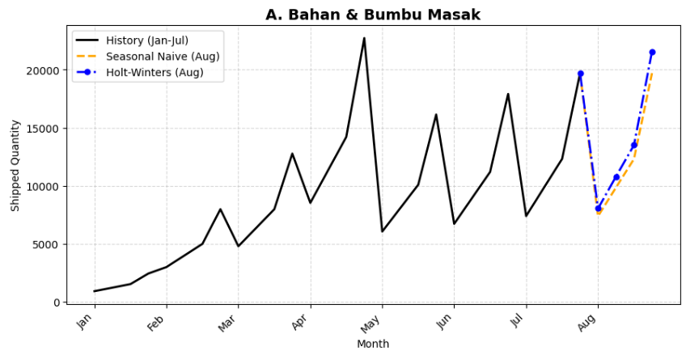
EDA - Cooking Ingredients
& Seasonings
Model Forecast Comparison
Sensasional Naive
49246
Holt-Winters
59547
MAPE 9.08% | MAPE 5.49%
Accuracy 90.92% | Accuracy 94.51%

Slide 13

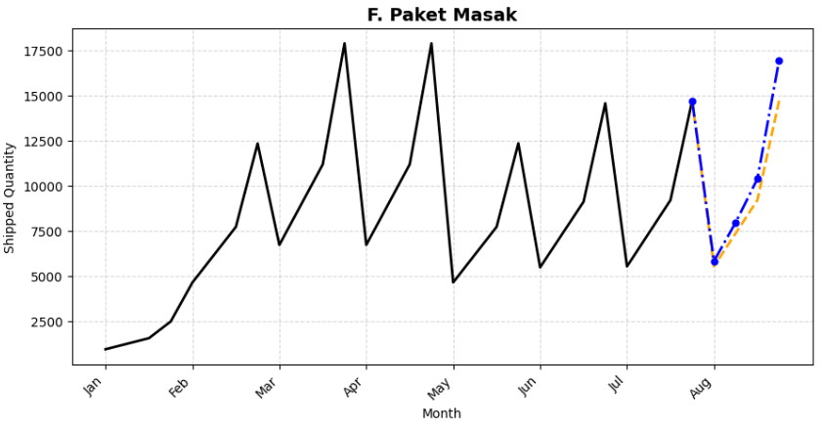
EDA - Cooking Kits
Model Forecast Comparison
Sensasional Naive
36740
Holt-Winters
42636
MAPE 0.99% | MAPE 7.43%
Accuracy 99.01% | Accuracy 92.57%

Slide 14

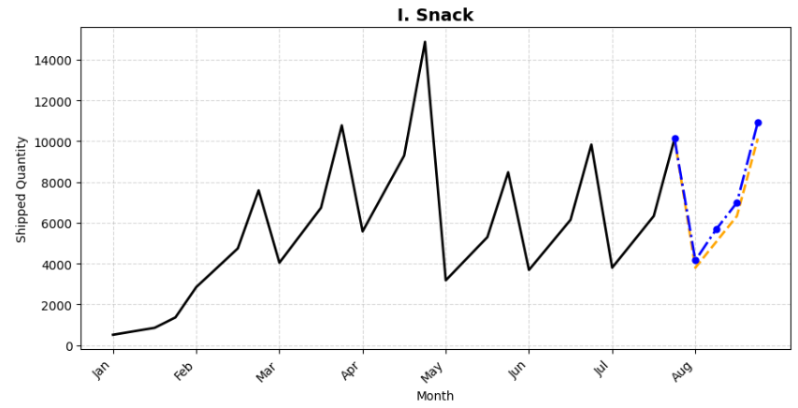
EDA - Snacks
Model Forecast Comparison
Sensasional Naive
25319
Holt-Winters
29206
MAPE 2.91% | MAPE 5.56%
Accuracy 97.09% | Accuracy 94.44%

Slide 15
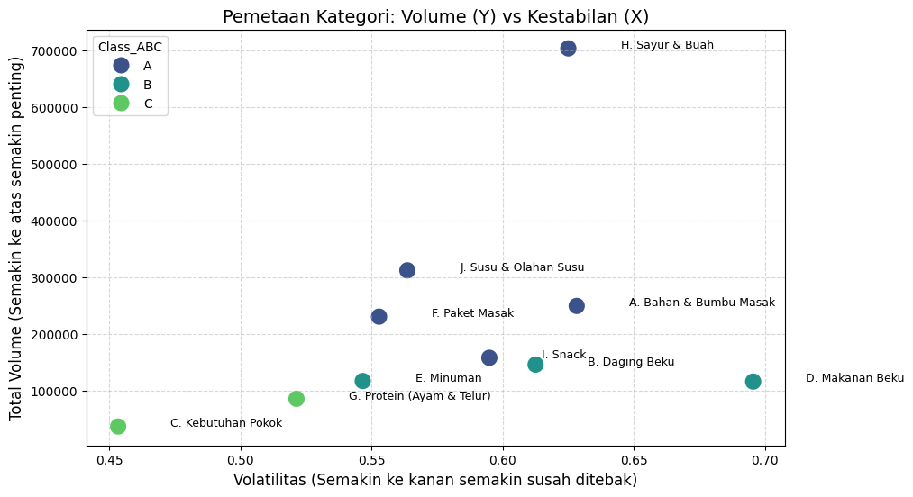
Clustering
Matrix
AX (Hot Items + Stable) | Vegetables & Fruits, Milk & Dairy Products, Cooking Ingredients & Seasonings, Cooking Kits, Snacks
BZ (Safety Stock) | Frozen Meat, Beverages, Frozen Foods
CY (Small Seasonal) | Protein (Chicken & Eggs)
CZ (Problem Child) | Staple Foods

Slide 16
04
Result & Recommendation

Slide 17
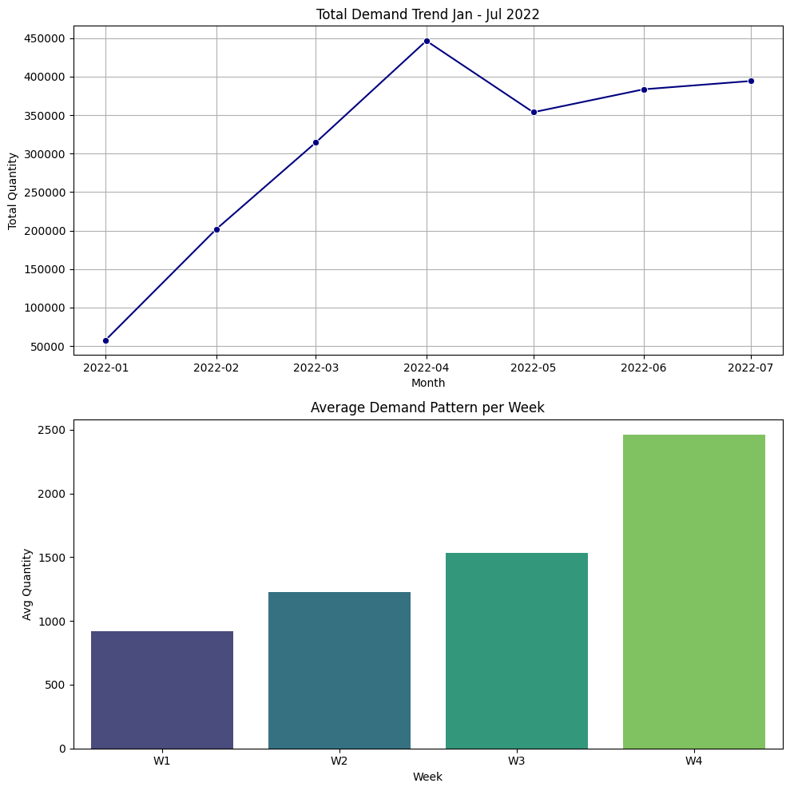



Observation
Business Growth
Weekly Pattern
Demand trends are rising consistently.
Weeks 1 & 2 steady demand and Week 4 demand skyrockets 2-3 times
Category Variations
Large categories have stabilized over the past two months and
Small/medium categories, despite low volumes, are still trending upward.

Slide 18
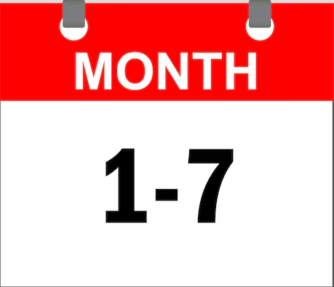

Background
Business Phase
Short-Term Data
Growth Phase
Our main category (Vegetables & Spices) has entered the Maturity phase, so the pattern is stable and repetitive
Historical data from the past seven months shows that consumer behavior in stable categories tends to repeat the patterns seen in the previous month.
Complementary categories (c) are still in the Introduction/Growth phase, which is why they are highly volatile and trending upward.

Slide 19
Insight
Holt-Winters Too Aggressive
Seasonal Naive is the winner
for the stable category (Class A), Holt-Winters tends to be overconfident and prone to overstocking.
the simple “Copy-Paste Last Month” method has been proven to have fewer errors.
Hybrid is Key
Stable goods require a conservative (Naive) method.
Growth goods require an aggressive (Holt-Winters) method.

Slide 20

Recommendation
Procurement Strategy - CRITICAL
Category AX (Vegetables/Spices)
BY/CY Category (Frozen/Snacks)
Safety Stock
Use Seasonal Naive forecast figures. Do not buy excessively following false trends. Focus on maintaining availability, not increasing stock recklessly.
Use Holt-Winters forecast figures. We must dare to stock more because demand is on the rise.
Add an extra 15-20% reserve stock specifically for categories ending in ‘Z’ (Frozen Meat & Staples) because the error rate is still high.
“Play it safe.”
“Go for it.”

Slide 21


Recommendation
Warehouse Strategy (Manpower)
Evaluation (Monitoring)
W4 Full Team: Maintain the ban on leave during the fourth week of August. Although category A is stable, the volume remains enormous and requires a lot of manpower.
Weekly Review: Check Category A stock every Friday. If Week 1 turns out to be busier than the Naive prediction, immediately switch to the Holt-Winters strategy for the rest of the month (dynamic in nature).

Slide 22
APPENDIX

Slide 23
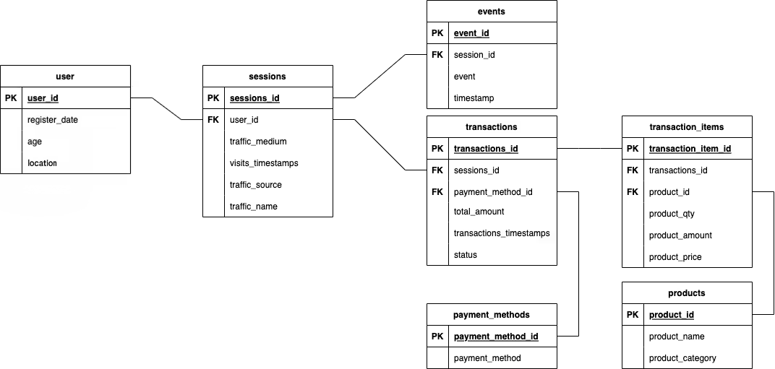
ERD

Slide 24
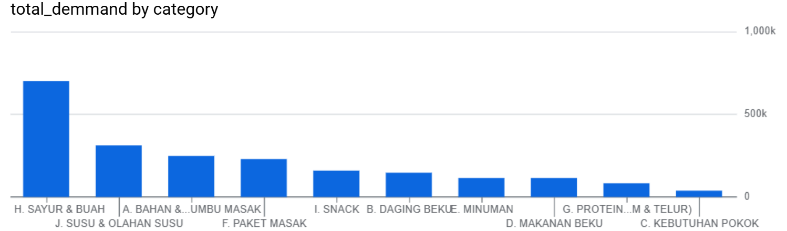
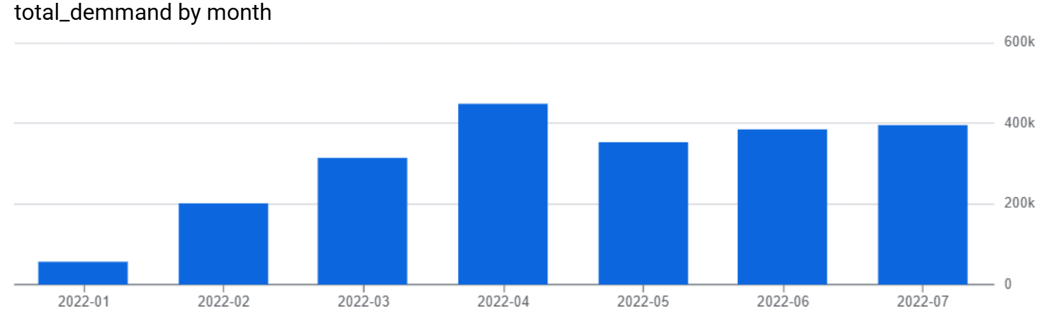
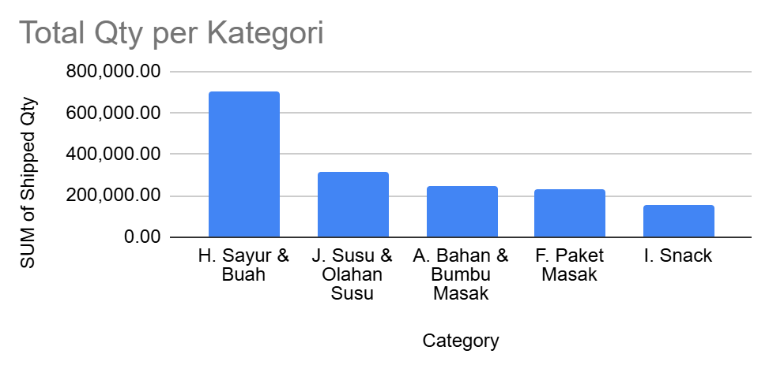
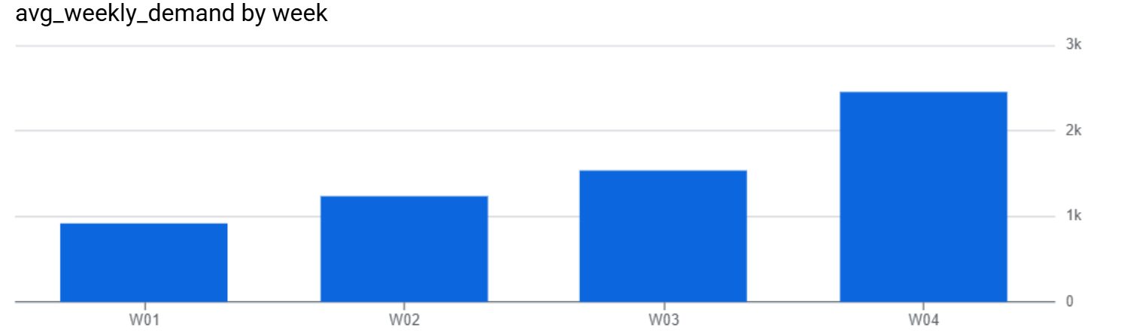
Dataset Overview
Time range 7 Months : Jan - Jul 2022 With 1.400 rows of weekly data from 5 different hubs.
Total volume (Shipped Qty) 2.152.036 unit.
Data Quality: 100% Clean. No missing values, so it is ready for immediate processing.
Locations (Hub) : 5 Hubs (A, B, C, D, and E).
Products : 10 Categories (ranging from Cooking Ingredients & Spices to Milk & Dairy Products).
Granularity data is recorded weekly (W1-W4), but we aggregate it monthly for restocking accuracy.

Slide 25


Result & Recommendations
Business Growth
Payday Effect
Holt-Winters (Multiplicative)
Demand trends are rising consistently.
Extreme spike in Week 4
Highest accuracy (captures upward trends and salary spikes)
Stock Priority
Critical (AX/AY): Vegetables & Fruits, Protein, Cooking Packages (Large Volume + Clear Pattern).
Volatile (BZ/CZ): Frozen Meat, Basic Necessities (Medium/Small Volume + Unpredictable Pattern).

Slide 26


THANK YOU
Contact Me - Mikhael Putra Iswanto
Looker Slide

